Slide 1
The Impact of EPS on Stock Price Action
– Based on Event Study and Bootstrapping
FRE-GY 6883 Final Project
Team Members
Siyun Wang
Boen Du
Jiawei Feng
Zhengxuan Yan
Feng Su
Jialin Xuan
By Team 2

Slide 2
Work Distribution
NAME | TASK
Siyun Wang | Task Allocation, Matrix Operator, Bootstrapping,Testing
Boen Du | Libcurl, Menu, Date Parsing, EPS grouping, Testing
Jiawei Feng | Libcurl, Stock Class Design, UML
Zhengxuan Yan | Libcurl, Stock Class Design, Multithreading
Feng Su | Stock Class Design, Gnuplot, Menu, UML
Jialin Xuan | API query, Matrix Operator, Gnuplot

Slide 3
Executive Summary
Objective: Discover market’s response to various levels of EPS surprises before and after the announcement date
Method: C++ Based Console Application, Bootstrapping method, AAR & CAAR Calculation
Marginal Contribution: C++ Multithreading, Flexible data retrieval
Result: A high surprise will often lead to a sharp increase in the stock price, while a low surprise to a rapid decline

Slide 4
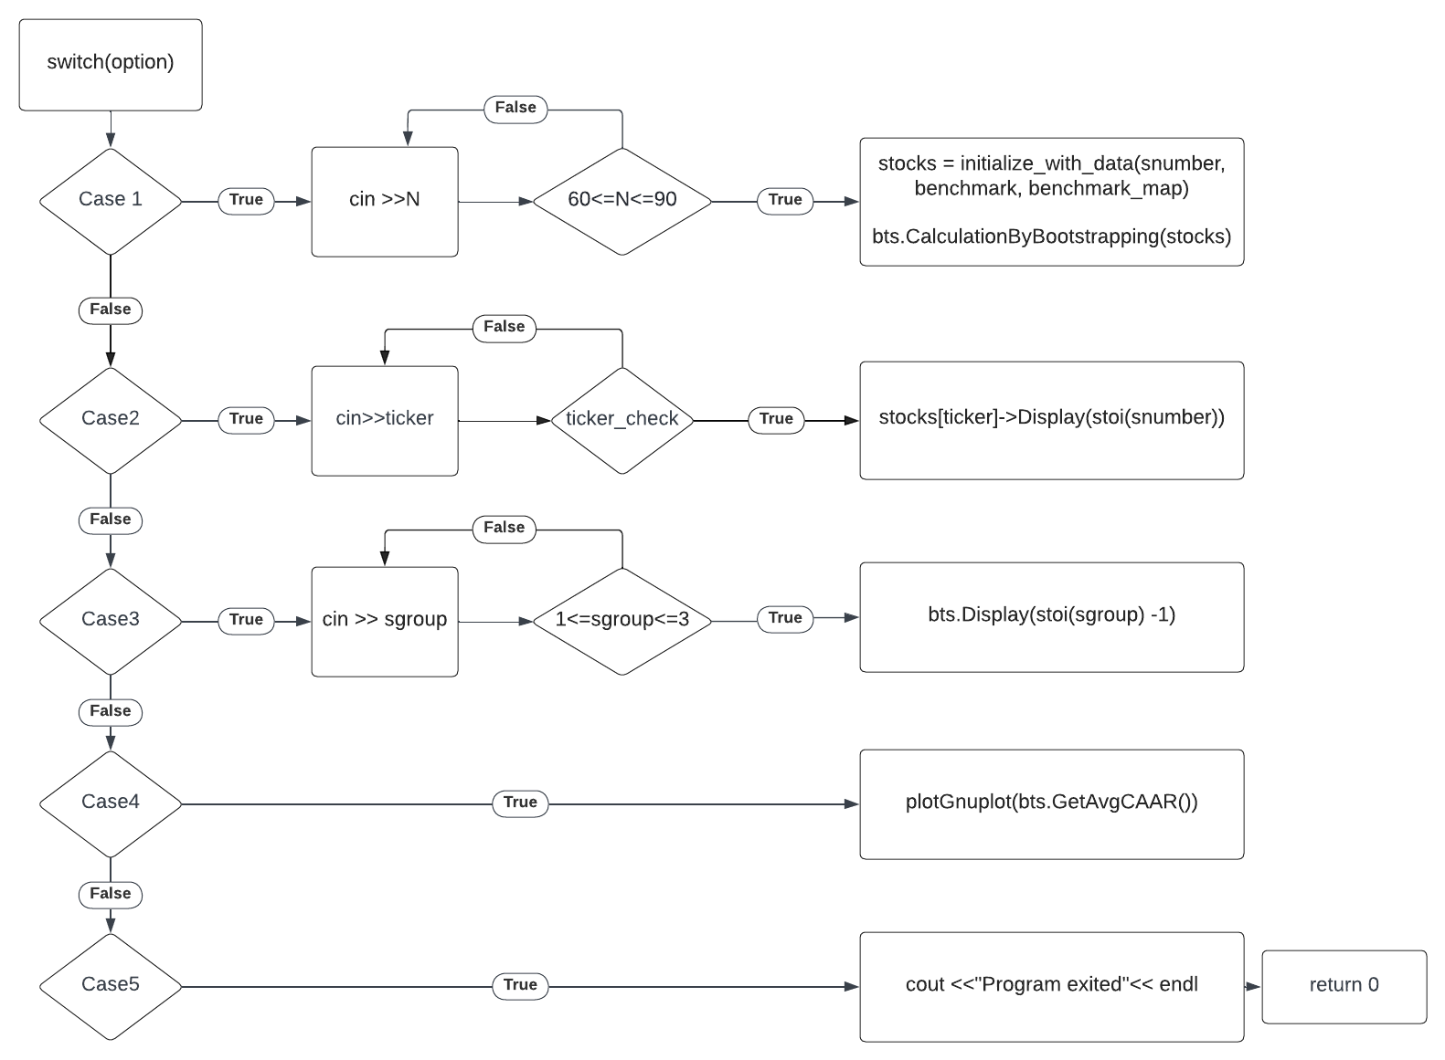
UML (Menu)

Slide 5
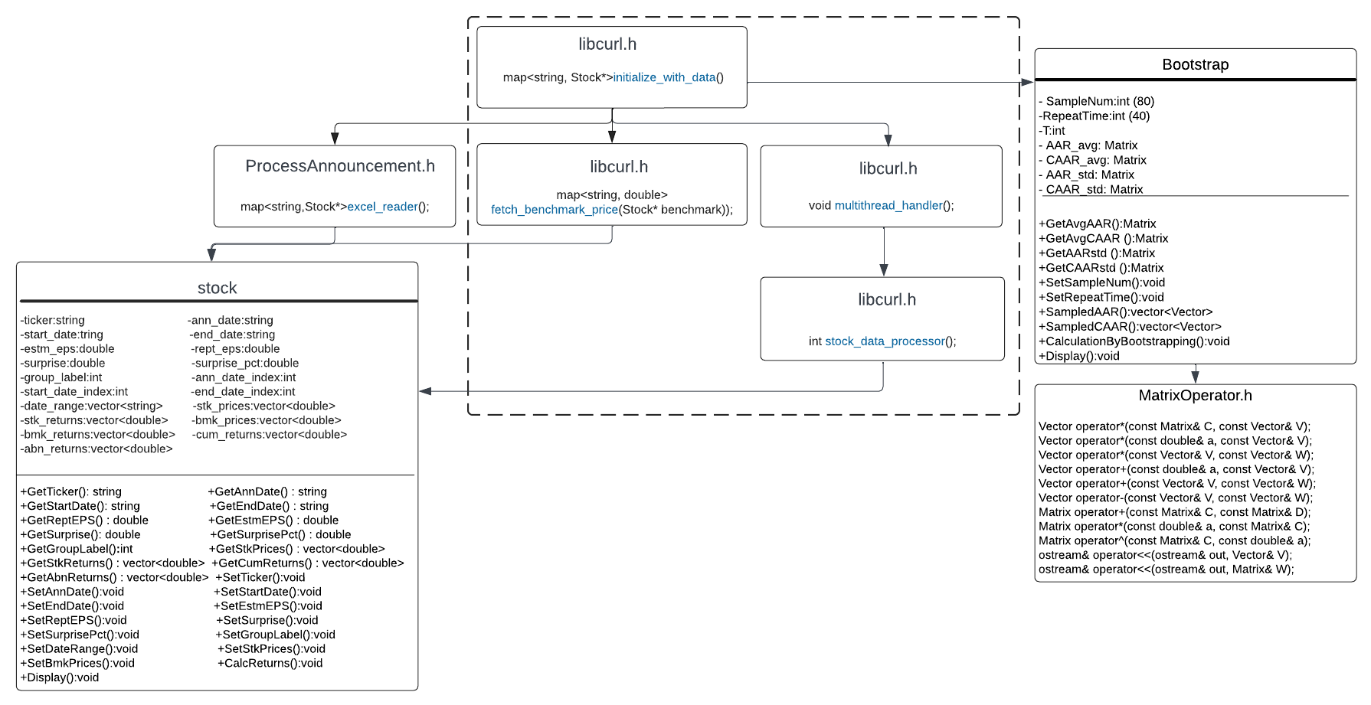
UML

Slide 6
PART1: Data extraction
Data structure design: Map for data of stocks
Libcurl configuration
Fetch earnings and surprise from excel files
Fetch Benchmark
Dynamically fetch prices for every stock based on valid trading dates and their announcement date
Select stocks from Russell 3000, excluding stocks that:
Lack of Earning Announcement Information in 2nd quarter of 2021;
Lack of enough historical data for 2N+1;
The announcement date in not a trading date.

Slide 7
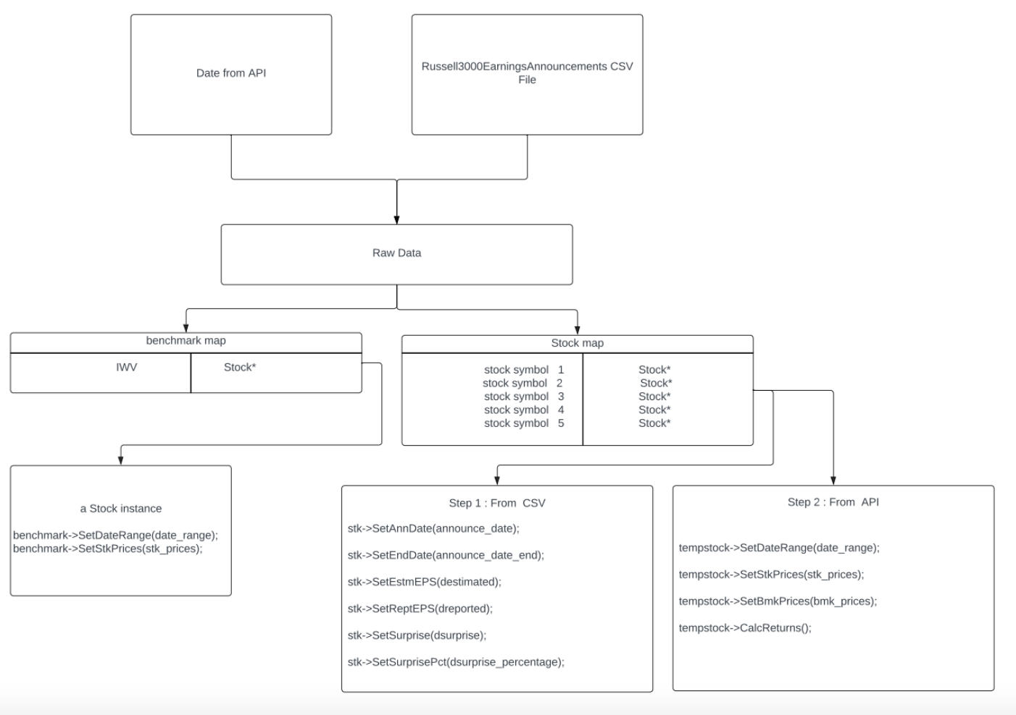
Stock Class and Stock Map

Slide 8
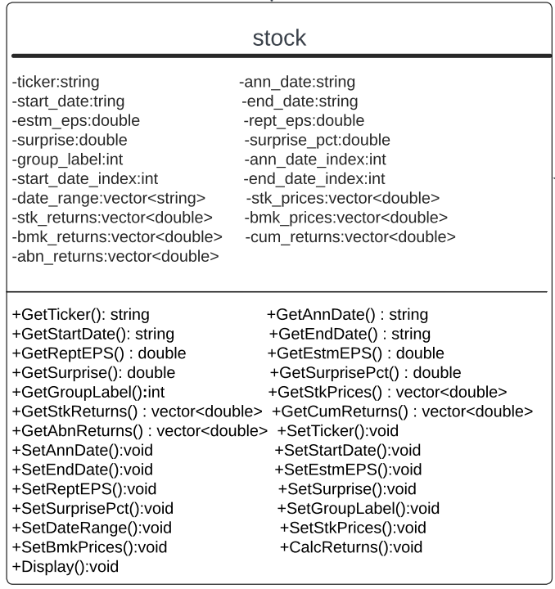
Stock Class
CalcReturns()
stock returns,
market benchmark returns, cumulative daily returns, abnormal returns
Display()
Display for case 2

Slide 9
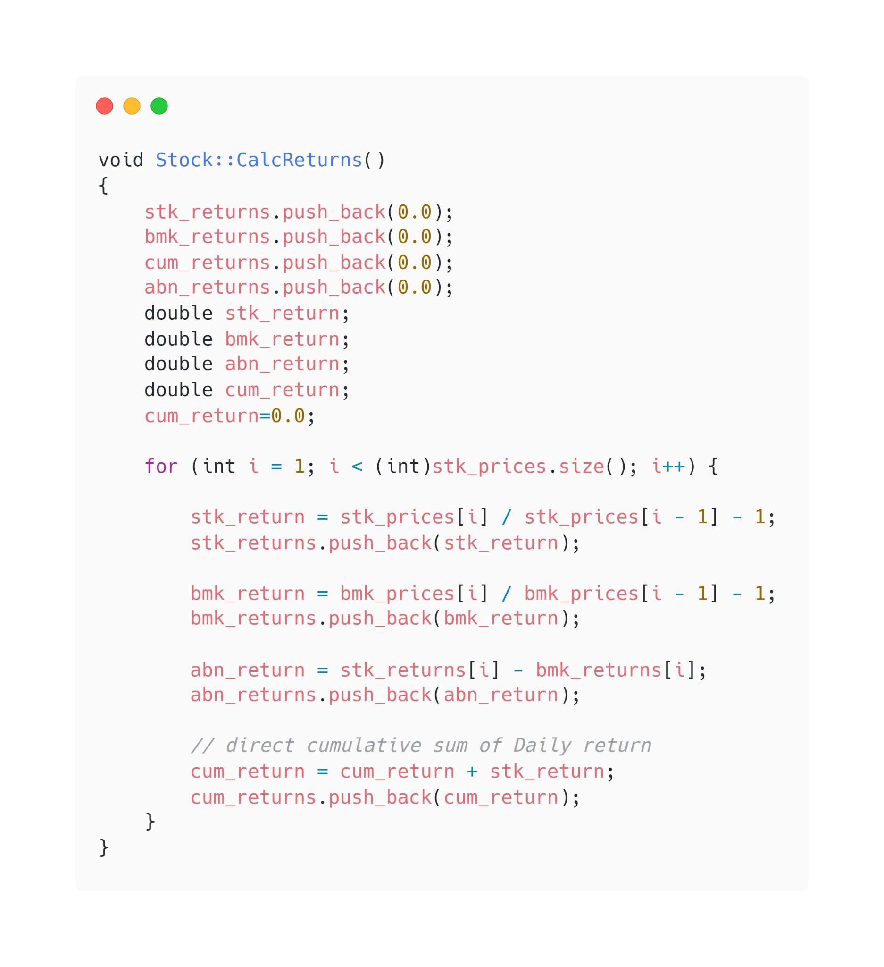
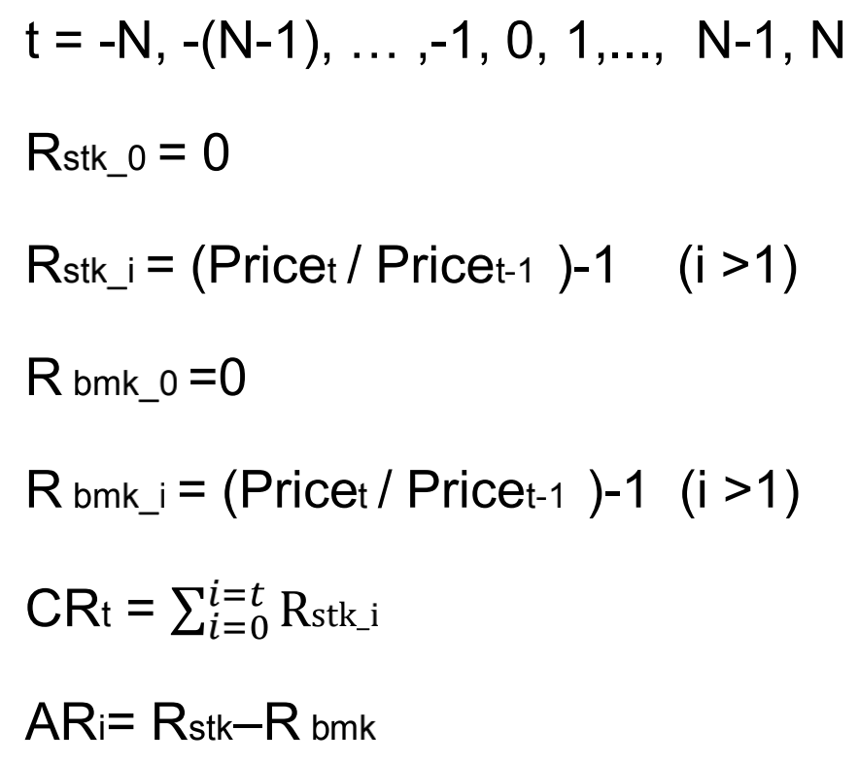
Calculation of Individual Stocks

Slide 10
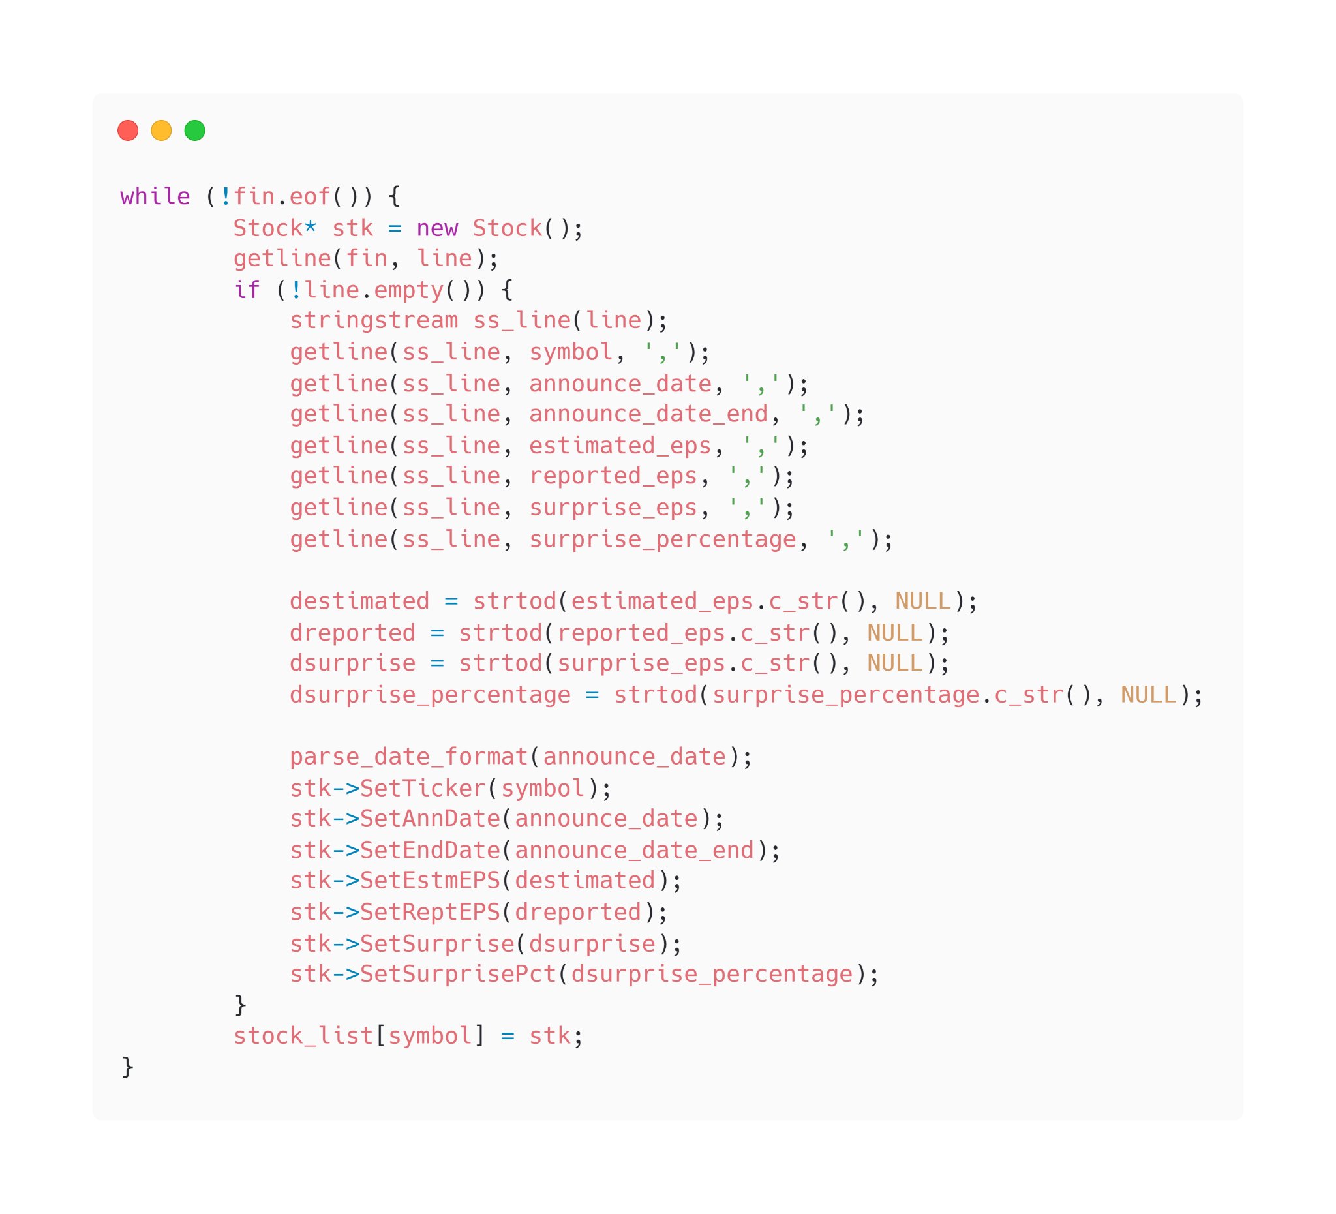
PART1: Data extraction
1. Read Announcements
Read data from excel file of earning announcement
Initialize map for stocks and fill with corresponding eps information
This map will be called by reference and be filled with prices and returns by other functions

Slide 11
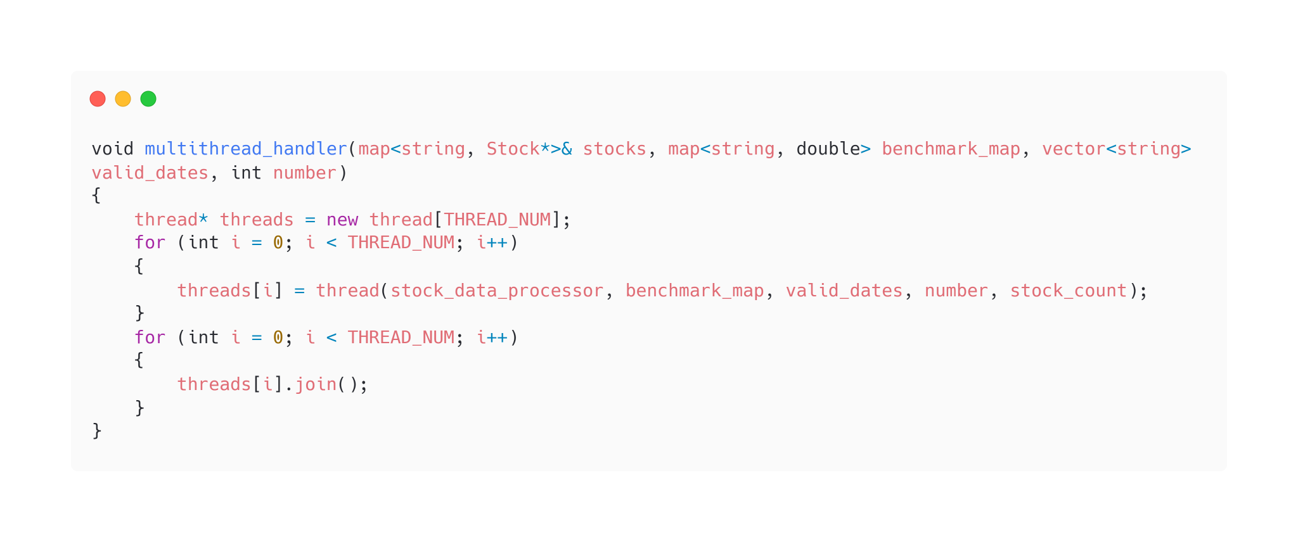
PART1: Data extraction
2. Multithreading
Improved running time from 750s to 115s for 8 cores (8 threads) machine for N=60.
Testing Network: Spectrum(300Mbps); Ping eodhistoricaldata.com average around 80ms.

Slide 12
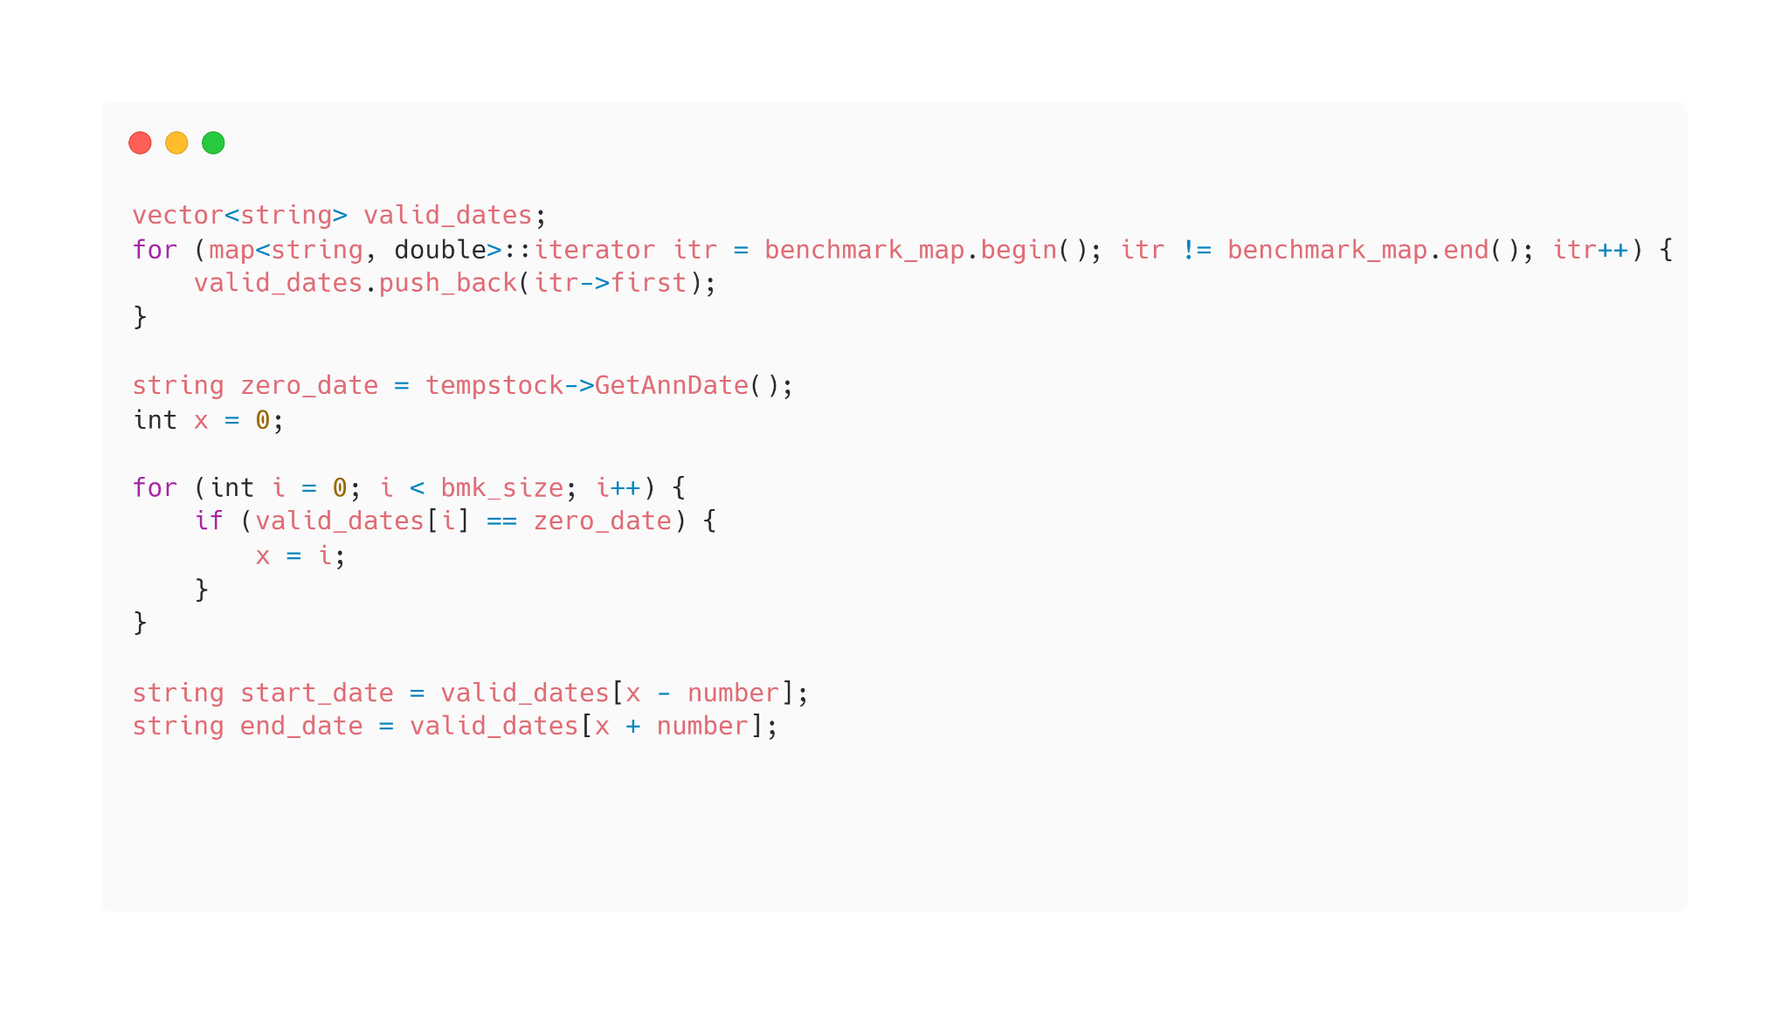
PART1: Data extraction
3. Dynamic Date Range
Only download days for -N to +N trading dates for each stock
Further improved running time from 115s to 81s under the same testing conditions.

Slide 13
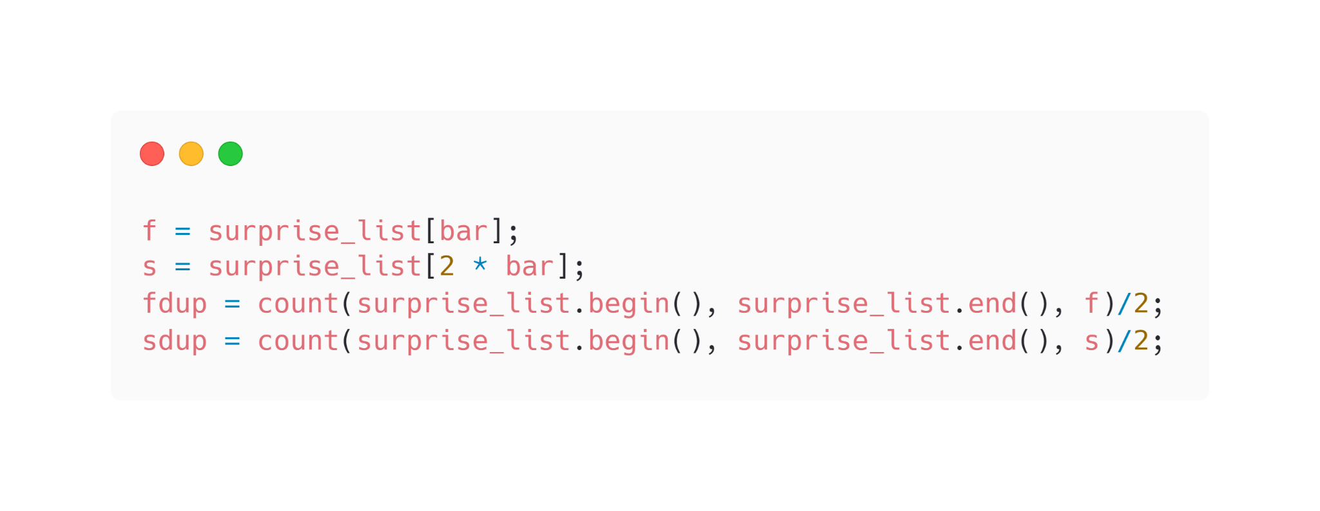
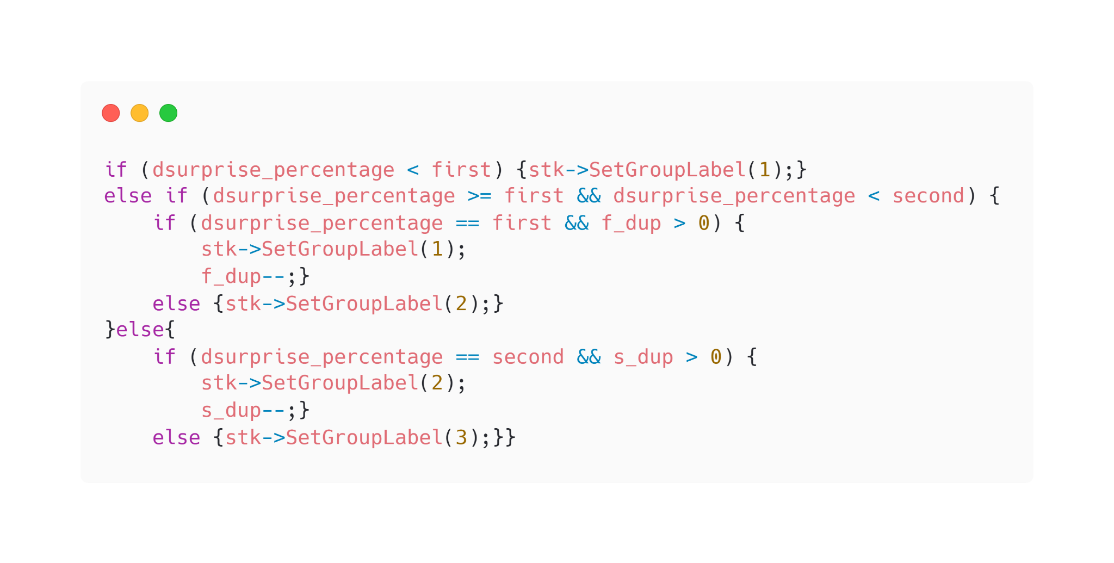
PART1: Data extraction
4. Grouping
Use a sorted list of “surprises”
Compute variable “bar” as the 0.33 quantile
Divide stocks into 3 groups to make sure there are roughly identical number of stocks in each group

Slide 14
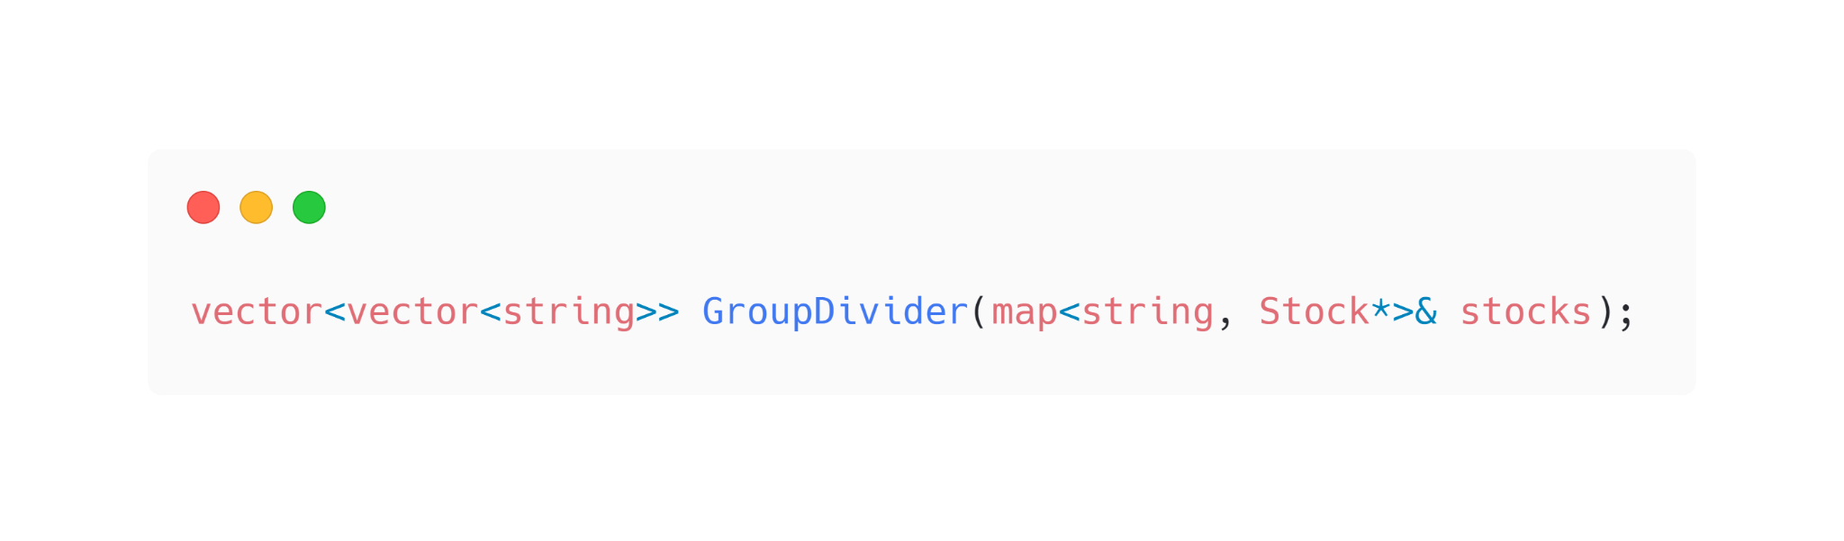
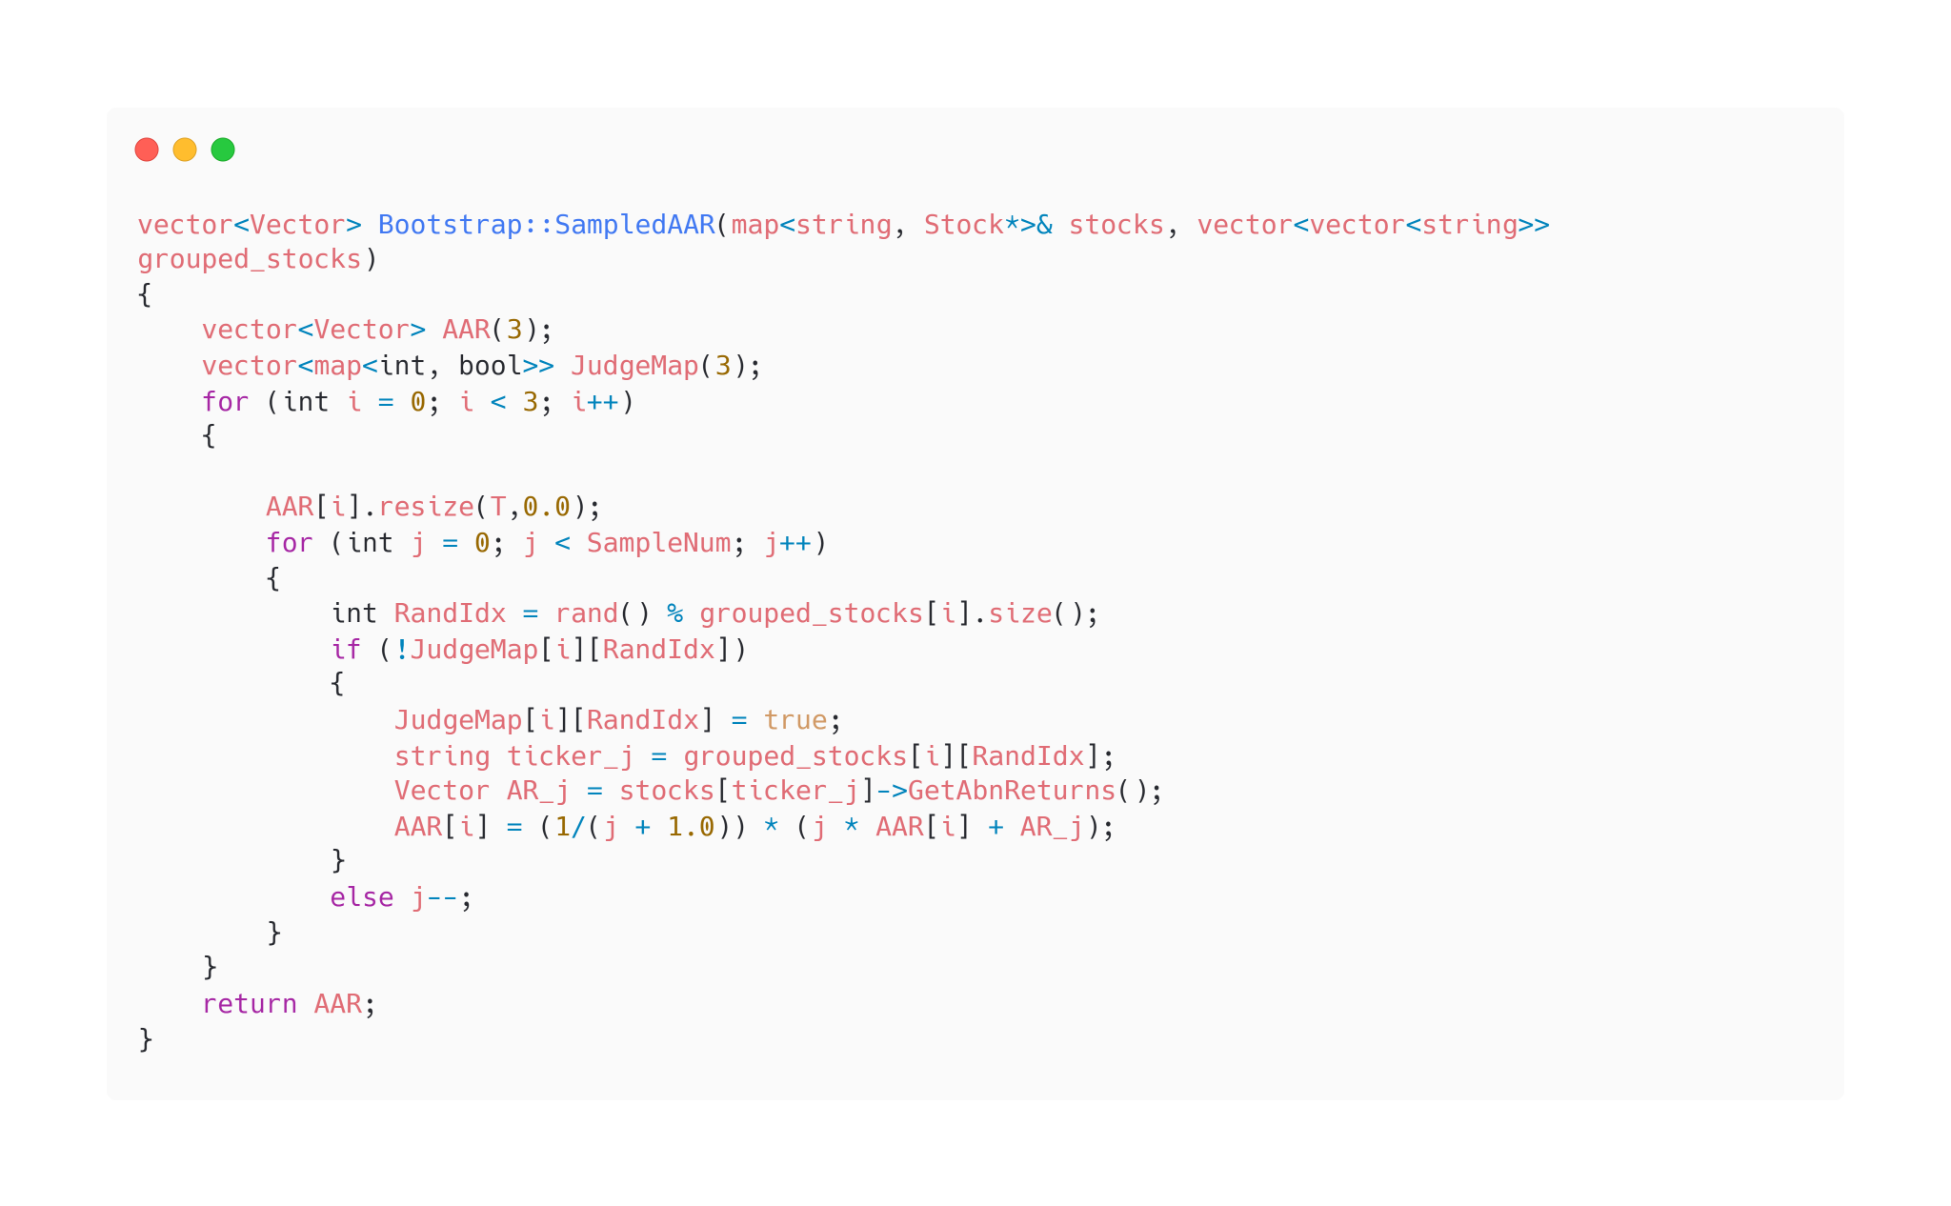
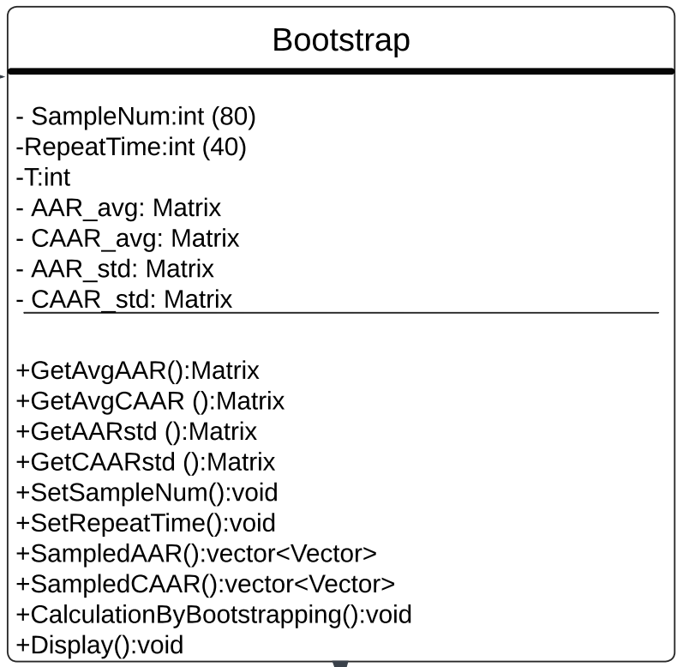
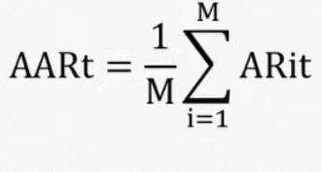
PART2: Calculation & Testing
1. Bootstrapping
Generate a stock ticker Vector for each group.
Generating random number ranging from [0, group_size-1];
Using a Judge Map to avoid duplicate sampling.

Slide 15
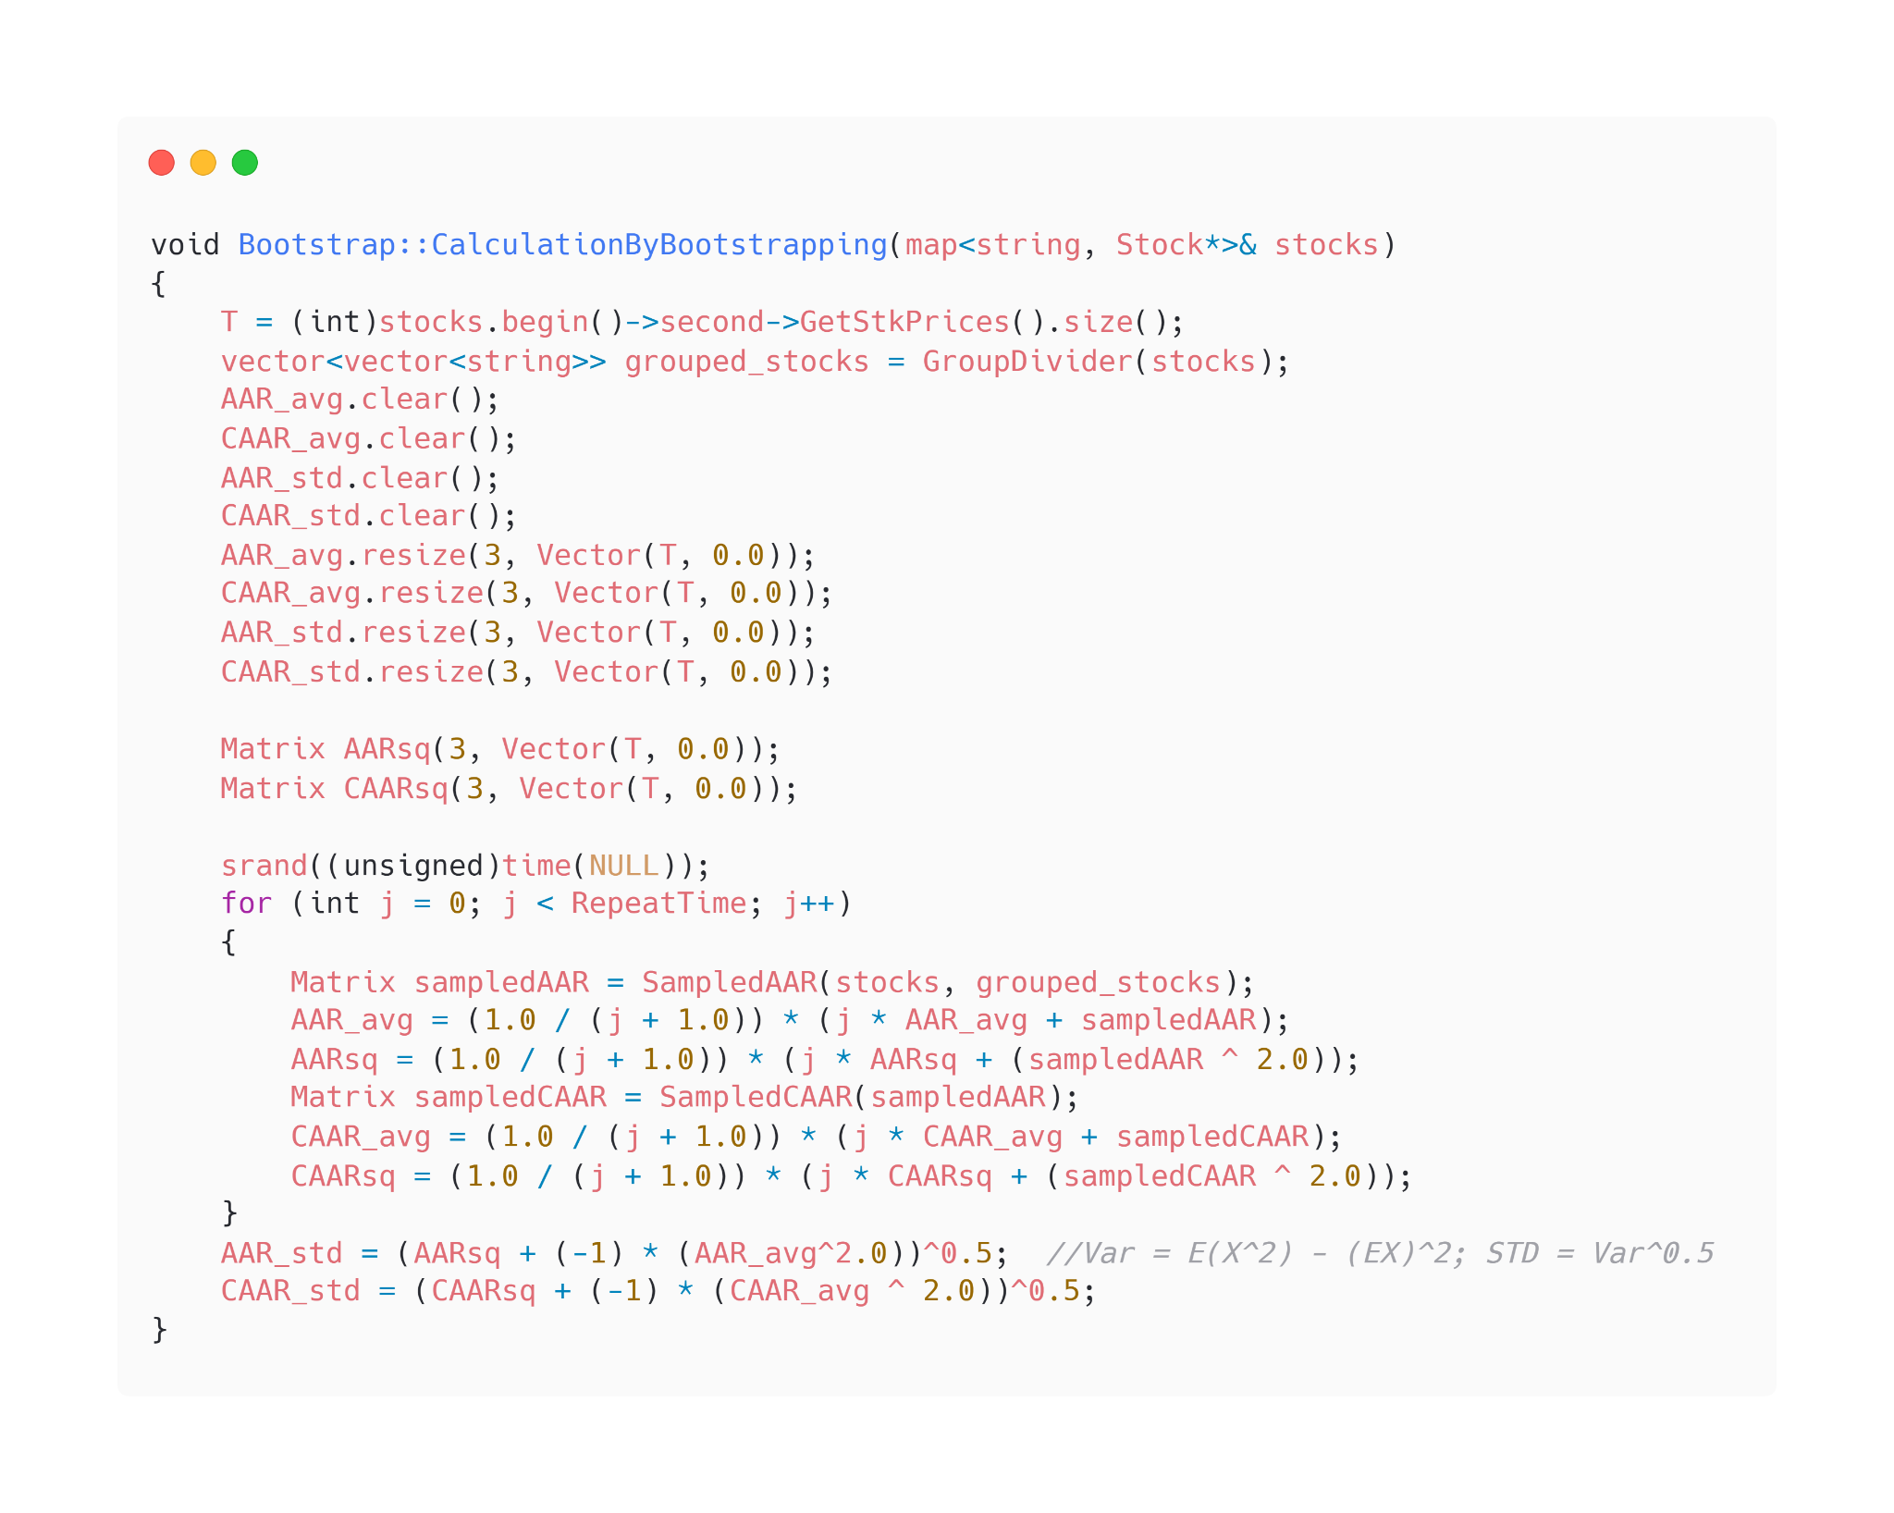
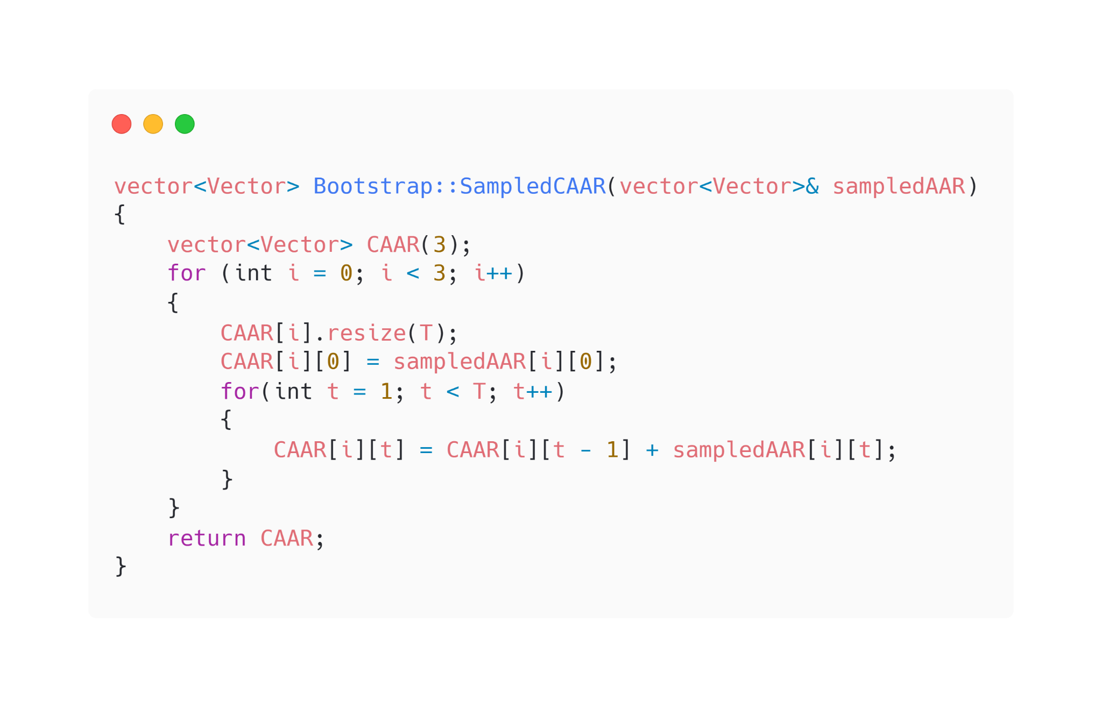

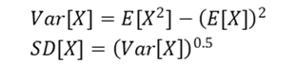
PART2: Calculation & Testing
1. Bootstrapping (Continue)
Enhancement: Using the formula to calculate E[X] and E[X²] during each sampling to avoid additional loop.

Slide 16
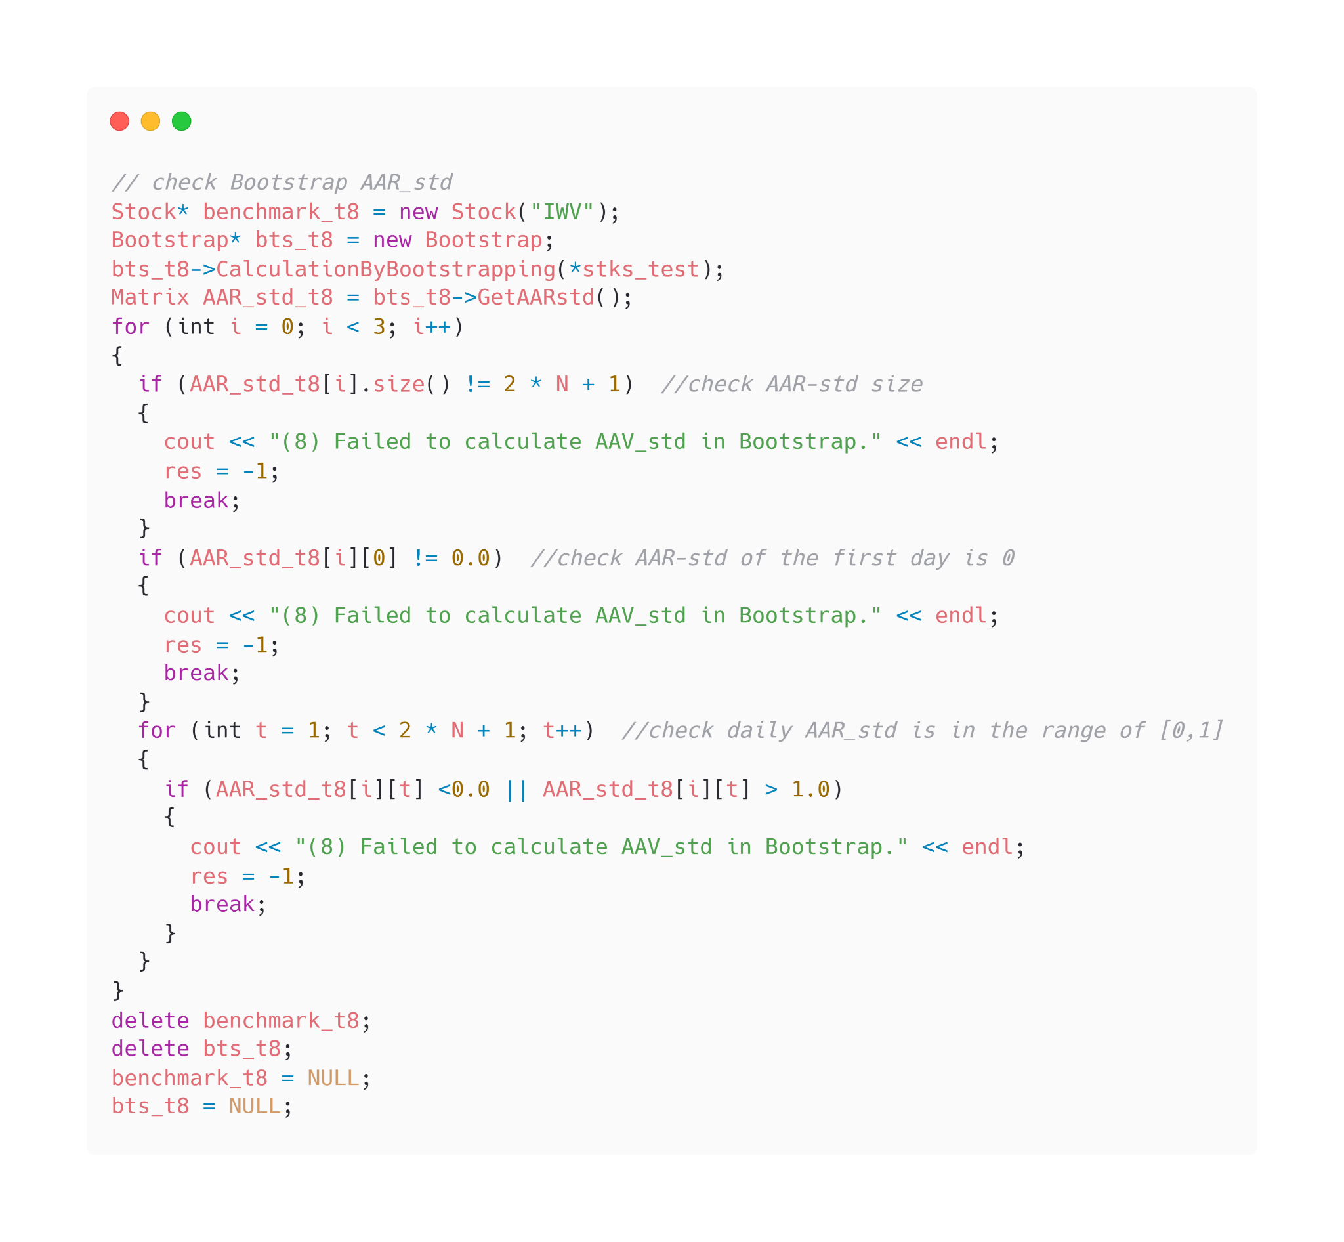
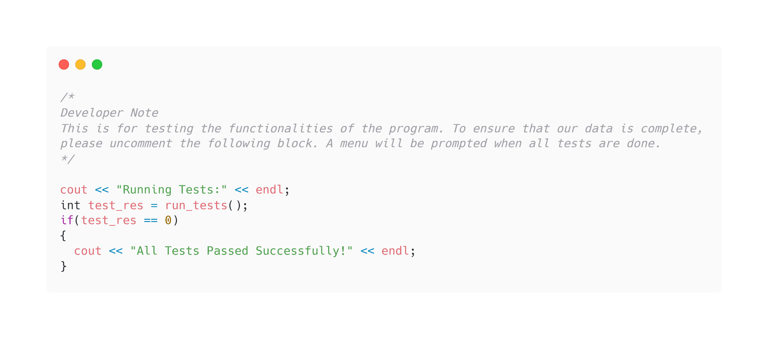
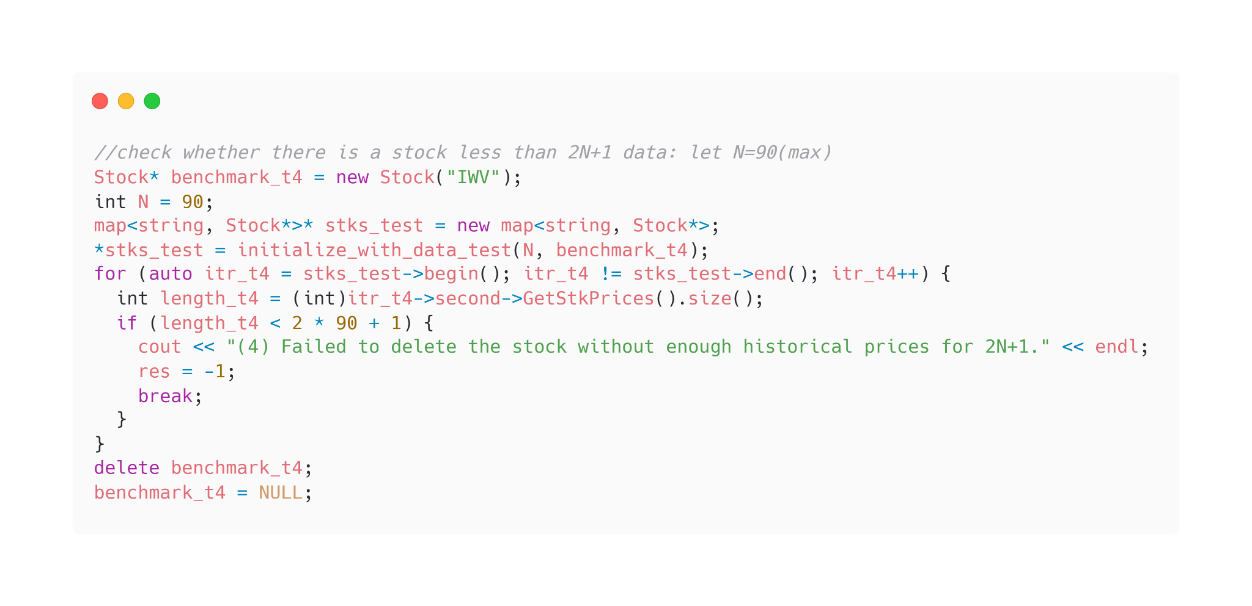
PART2: Calculation & Testing
2. Testing
Check Stock Selection, Retrieving, Grouping, Individual Stock Calculation, Bootstrapping Calculation…

Slide 17
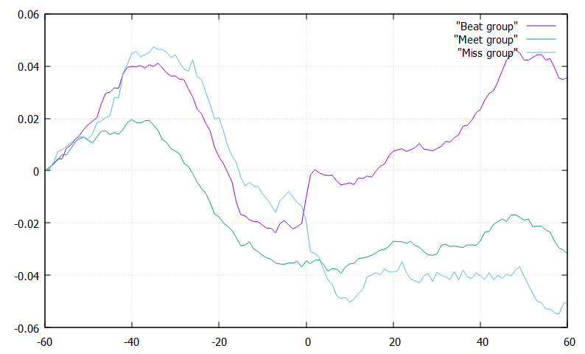
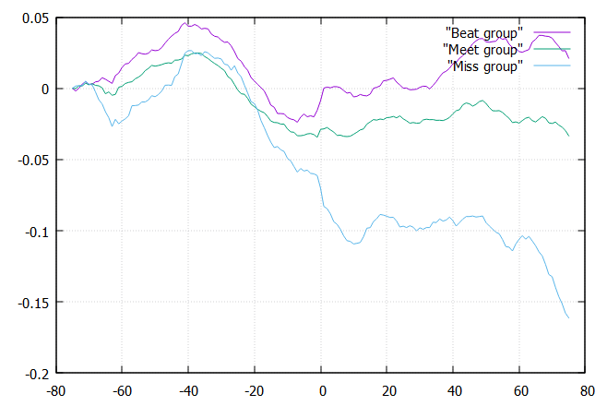
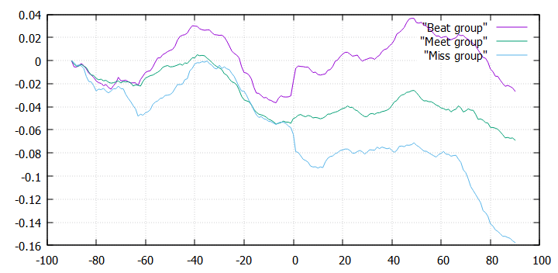
PART3: Outcome
1. gnuplot
N=60
N=75
N=90

Slide 18
Conclusion
● After announcement day, stocks in Beat group show the highest abnormal returns while stocks in Miss group show lowest abnormal return. The investors react quickly to the earnings surprise information and the effects are long-lasting.
● Around 10 days before announcement day, stocks in Beat and Meet groups begin to show an upward trend, while stocks in Miss group begin to show a downward trend. This shows investors may get to know some unpublished information a short period before the announcement day.

Slide 19
Concern and Improvement
Concern: Cumulative sum of arithmetic return does not make financial sense.
Improvement: Use log returns to sum or use arithmetic returns to multiply.

Slide 20
Reference
● random number function
https://www.cplusplus.com/reference/cstdlib/rand/
● Multithreading in C++
https://www.geeksforgeeks.org/multithreading-in-cpp/
● gnuplot for C++
http://stahlke.org/dan/gnuplot-iostream/
● libcurl for C++
https://www.apriorit.com/dev-blog/344-libcurl-usage-downloading-protocols

Slide 21
THANK YOU

